Slide 1


Advice First Aid Bitesize: The Benefit Cap 3.3.26
Natasha Cross

Slide 2
Aims of Today
To understand the Benefit Cap in more detail​ and the effects it has
​
To understand how Housing and the 2 Child Limit affect the Benefit cap
​
To identify ways in which a client may be exempt from the Benefit Cap
Notes:
2

Slide 3

Introductions
Name and Organisation
Have you experienced clients with Benefit Cap issues in your community?
Notes:
3

Slide 4
Disclaimer
Although Citizens Advice Wandsworth trains volunteers to identify local residents in need of advice and refer residents to local services, no liability attaches to Citizens Advice for any assistance or service offered by other organisations. ​
Equally as volunteers , we are not training you to be advisers. The additional training helps us to better understand guest’s needs and refer them on to the right places for support, advice and further help.

Slide 5

Who are Citizens Advice Wandsworth?
We are an independent local charity and part of the national Citizens Advice network. We:
Provide information and advice for people who live in Wandsworth on a range of issues
Spot patterns with the problems our clients bring, and try to raise these in local and national policy
Work with partners to empower the community

Slide 6
Citizen’s Advice Aims and Principles
Aims​
To provide advice people need for the problems they face​
To improve the policies and practices that affect people's lives ​
Principals​
Independence​
Impartiality​
Free​
Confidentiality​
www.citizensadvice.org.uk​
https://cawandsworth.org/

Slide 7




How to contact CAW
Call AdviceLi​ne free number 0808 278 7833​
Mon-Fri 10am-4pm​
Fill in online enquiry form https://cawandsworth.org/contact-us/
Visit Battersea or Roehampton office.
Only if not possible to call/use the form
Via one of our projects (Crisis) https://cawandsworth.org/crisis-project-referral-form/

Slide 8

The Benefit Cap

Slide 9

Definition
The benefit cap is a limit on the total amount of benefits you can get. It applies to most people aged 16 or over who have not reached State Pension age.
Universal Credit
Bereavement Allowance
Child Benefit
Employment and Support Allowance
Housing Benefit
Incapacity Benefit
Income Support
Jobseeker’s Allowance
Maternity Allowance
Severe Disablement Allowance
Widowed Parent’s Allowance

Slide 10
Background: 2013
The benefit cap was introduced in April 2013 in Bromley, Croydon, Enfield and Haringey and then with all other councils applying the cap to households in receipt of HB between July and September 2013
Welfare Reform Act 2012
Part of larger reforms to Welfare Benefits system including Universal Credit

Slide 11
History of the Cap
2013 : the cap was £500 a week for households (with children) in London
2016: Reduced to £442 a week
2023/2024 onwards: The Benefit Cap had not risen until April 2023 when it rose by 10.1% to £486.98 a week
If the benefit cap had been increased with inflation from its implementation, the cap in 2023/24 would be £640 a week, £200 a week higher in London
https://cpag.org.uk/sites/default/files/2023-08/Benefit%20cap-%20cost%20of%20living%20in%20a%20crisis.pdf

Slide 12
The Benefit Cap
​ | Couples (with or without children) and single parents​ | Single people​
2025/26 Rate​ (same as 2026-27) Greater London​ | £2,110.25 (monthly)​ ​ £486.98 (weekly)​ | £1,413.92 (monthly)​ ​ £326.29 (weekly)​
2025/26 Rate​ (same as 2026-27) Outside Greater London​ | £1,835 (monthly)​ ​ £423.46 (weekly)​ | £1,229.42 (Monthly)​ ​ £283.71 (weekly)​
Notes:
Benefits included in the cap:
housing benefit (unless you live in supported housing)
income support
jobseeker's allowance
employment and support allowance (unless you are in the support group)
incapacity benefit
child benefit and child tax credits
guardian's allowance
carer's allowance
maternity benefits and widows
universal credit
Exceptions:
LCWRA
UC as a Carer
Get WTC
Single or couple earning over £658 net
PIP
Carers Allowance
State pension age
9m grace period for UC if just lost job or earning reduced.
Rates only increased in 2023 for first time

Slide 13

The Two Child Limit
The Two Child Limit restricts claims on Universal Credit to 2x Child Elements for children born after April 2017. You can only claim for your third (or more) if:
They were born before 6 April 2017, or
They are disabled (Disabled Child element only), or
Special circumstances (exceptions) apply to your Universal Credit claim

Slide 14

2 Child Limit Scrapped!
From April 2026, the government is scrapping the two-child limit on Universal Credit

Slide 15
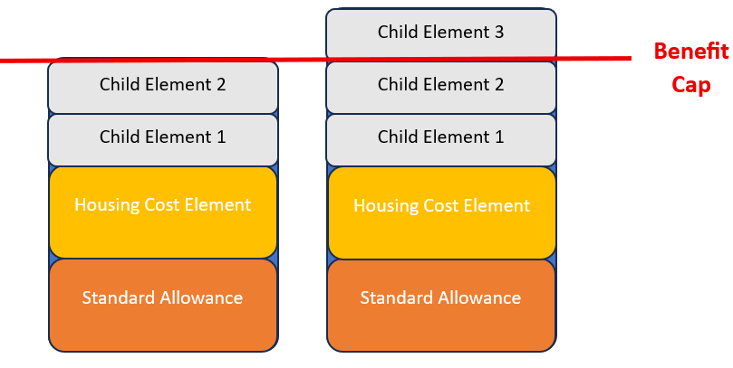
The Benefit Cap and the 2-Child Limit
BUT households who can claim more money for their children won’t necessarily see an actual rise in income due to the benefit cap

Slide 16
Save the Children research
Families out of work may not see an increase in income after the two-child limit is lifted. The government's impact assessment estimates around 70,000 families will not see the full increase as a result. Families where someone is disabled or seriously ill are exempt from the cap.
Most families affected - 59% - are in work.
40% of affected families include someone who is disabled, and 27% include a disabled child.
https://www.savethechildren.org.uk/blogs/2026/two-child-limit-fact-seet

Slide 17
Impact of Benefit Cap on Housing

Slide 18
The Benefit Cap and Housing
Rent prices are increasing
(Zoopla calculated an increase of 36% between 2020 and 2025 Source: BBC)
+
The Benefit Cap NOT increasing
(Decreased in 2016, Increased in 2023, no further increases)
=
Rent is taking up more proportion of the Benefit Cap amount
“Affordable” housing for someone who is Benefit Capped is VERY difficult to find

Slide 19
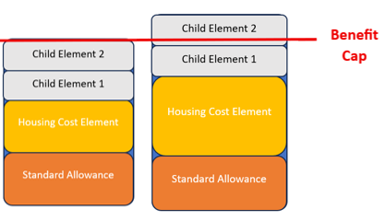
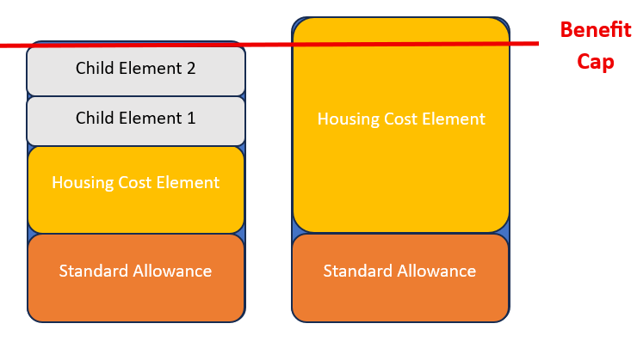
Benefit Cap and Housing
Rent vs Clothes etc for Kids
Rent vs Bills/Food

Slide 20
Exemptions from the Benefit Cap

Slide 21
Earnings Exemption
If you (and your partner) earn £846 or more a month combined, after tax and National Insurance contributions

Slide 22

Disability Benefits Exemptions
No Benefit Cap if…
If you or your partner receive LCWRA (Limited Capability for Work and Work Related Activity) element
If you, your partner or any children under 18 living with you gets
Disability Living Allowance
Personal Independence Payment
Attendance Allowance

Slide 23
Carer Exemption
No Benefit Cap applies if you are a carer and receive Carer’s Element on UC or Carer’s Allowance

Slide 24
Age Exemption
No Benefit Cap applies if you’re over State Pension age. If you’re part of a couple and one of you is under State Pension age, the cap may apply.

Slide 25
Grace Period
The Benefit Cap will not apply for 9 months if…
You’re claiming Universal Credit because you stopped working or your earnings went down and
You’re now earning less than £846 a month and
In each of the 12 months before your earnings went down or you stopped working, you earned the same as or more than the earnings threshold (£846 per month)

Slide 26
Help with the Benefit Cap

Slide 27

How to help clients as Advice First Aiders?
Benefit Calculators
Turn2Us
Entitledto
Chronic Health condition in the household - suggest disability benefits application
Check if they have just lost their job – Grace Period
Refer to CAW! https://cawandsworth.org/crisis-project-referral-form/

Slide 28

What can Citizens Advice do to help?
Check for any exemptions and help apply for benefit applications
Assist the client to request a Discretionary Housing Payment from the council
Advice on employment options

Slide 29

Work Support
Benefit Cap exemption = client + partner earn over £846 per month combined income
https://www.wandsworthworkmatch.org/
https://www.choicesupport.org.uk/find-support/find-support-near-you/richmond-wandsworth
https://www.wandsworth.gov.uk/news/news-july-2025/new-connect-to-work-scheme-helps-people-back-into-employment/

Slide 30

Any Questions?

Slide 31
Thank You

