Slide 1


Universal Credit and Advocacy
18th March 2026
Natasha Cross

Slide 2
Aims of Today
  To understand the main issues that clients have with Universal Credit
  To be aware of what action the clients can take or where they can get further advice
  To understand the rights to advocacy support for clients who cannot advocate for themselves
  To share any issues you are seeing in your communities with the group
Notes:
2

Slide 3

Introductions
Name and Organisation
What are the issues you experience in your community?
Notes:
4

Slide 4
Disclaimer
Although Citizens Advice Wandsworth trains volunteers to identify local residents in need of advice and refer residents to local services, no liability attaches to Citizens Advice for any assistance or service offered by other organisations. ​
Equally as volunteers , we are not training you to be advisers. The additional training helps us to better understand guest’s needs and refer them on to the right places for support, advice and further help.

Slide 5

Who are Citizens Advice Wandsworth?
We are an independent local charity and part of the national Citizens Advice network. We:
Provide information and advice for people who live in Wandsworth on a range of issues
Spot patterns with the problems our clients bring, and try to raise these in local and national policy
Work with partners to empower the community

Slide 6
Citizen’s Advice Aims and Principles
Aims​
To provide advice people need for the problems they face​
To improve the policies and practices that affect people's lives ​
Principals​
Independence​
Impartiality​
Free​
Confidentiality​
www.citizensadvice.org.uk​
https://cawandsworth.org/

Slide 7




How to contact CAW
Call AdviceLi​ne free number 0808 278 7833​
Mon-Fri 10am-4pm​
Fill in online enquiry form
https://cawandsworth.org/contact-us/
Visit Battersea or Roehampton office.
Only if not possible to call/use the form
Via one of our projects (Crisis)
https://cawandsworth.org/crisis-project-referral-form/

Slide 8

Universal Credit: Common Issues and Solutions

Slide 9
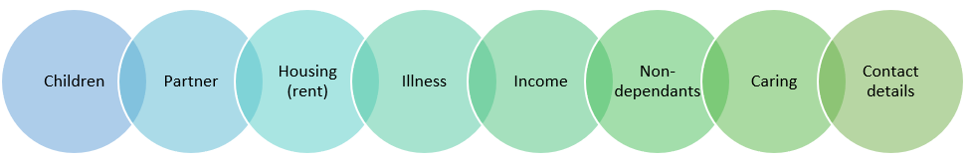
Change of Circumstances
Always report as soon as possible
Takes effect from the first day of the monthly assessment period in which the change occurred, or is expected to occur
If someone has reported a change late and UC do not backdate it, seek advice
If someone reports a change late that means they are entitled to less money/UC find out, this generates an overpayment > seek advice

Slide 10

Absences from the UK
1 Month Absence for any reason
2 Months Absence if your absence is in connection with the death of your partner or child or close relative (parent in law, siblings, son/daughter-inlaw, step parents, partners of these)
6 Months absence if you are a mariner or continental shelf worker;
6 Months absence if you are travelling away for medical treatment or accompanying child/partner for this.

Slide 11

Work Capability Assessment
If someone has chronic health issues meaning they cannot work, or cannot engage in Work-related activities they should tell UC
Provide fit-notes for 3 months = triggers referral for a Work capability assessment.
2 Groups
  Limited Capability for Work (LCW)- cannot work, expected to work in the future, work commitments are reduced, no extra money
  Limited Capability for Work Related Activity (LCWRA)- cannot work or engage in activities, high threshold of disability, no work commitments, +£423.27, Benefit Cap lifted

Slide 12
Deductions
Rent Arrears: usually 10% of standard allowance
Utility debt recovery : 5% of standard allowance
Child Maintenance: £8.40pw
Non –Dependent deductions: -£93.02 from Housing Cost element per non-dependent
Advance payment repayment: 24 months - if due to a new claim, 12 months if it’s a Budgeting Advance source
Overpayment recovery : Maximum is 15% of standard allowance
In practice, deductions of any kind from UC do not usually exceed 15 % of standard allowance (£60.02 if single and 25+/ £94.22 if in couple and one person is 25+)

Slide 13
Income – What counts?
Carers Allowance - £ for £ (If you receive £300 per month, £300 will be taken off UC entitlement)
ESA contribution benefit - £ for £
Maternity allowance- £ for £
Wages- For every £1 earned from working, Universal Credit payment goes down by 55p (55%). (£100 in income would mean -£55 from UC entitlement)
Work Allowance: If you have children or health issue and claim Housing Costs, you can earn £411 before UC starts deducting earnings

Slide 14
Sanctions
Benefit is paid at a reduced rate if someone does not meet work-related requirements
A daily amount (rate) of someone's full UC standard allowance will be taken off for each day the sanction applies.
Single 25+ : -£13.10 per day
Couple 25+: -£10.30

Slide 15
Sanctions- How long is someone sanctioned?
Rate | Reason | Duration
High | Failing to apply for or accept paid work Ceasing paid work or losing pay by choice or through misconduct | 91 days Could be doubled if had a high sanction already in the last year
Medium | Failing to do enough to get work e.g Not applying for a job when asked to Not being available for work/interviews | 28 days Can be 91 days if had a medium sanction already in the last year
Low | Any other failures e.g: Failing to attend appointment Failing to take particular action to get paid work | 7 days + however long it takes to do the required action

Slide 16
Sanctions
Speak to Work coach, explain why someone did or did not do something, provide "good reason",
Inform in advance where possible
Challenge decision
Seek advice
May be able to get UC hardship payments if someone has been sanctioned.

Slide 17
Benefit cap
 | Couples (with or without children) and single parents | Single people
2025/26 Rate (same as 2026-27) Greater London | £2,110.25 (monthly) £486.98 (weekly) | £1,413.92 (monthly) £326.29 (weekly)
2025/26 Rate (same as 2026-27) Outside Greater London | £1,835 (monthly) £423.46 (weekly) | £1,229.42 (Monthly) £283.71 (weekly)

Slide 18
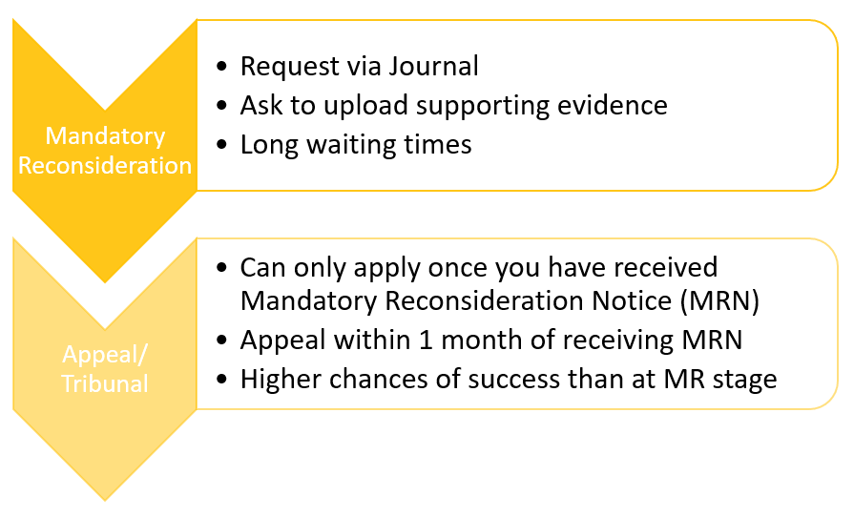
Challenging decisions

Slide 19
Advice and Solutions
Talk to UC
Write on the journal
Report change of circumstances
Inform if cannot make appointment
Benefit Calculator
Turn 2 Us
Seek Advice
Signpost clients to Citizens Advice, other local organisations who provide benefits advice (e.g Age UK, CARAS)
Entitled To
Refer clients

Slide 20

Benefit Calculators
Challenging a (simple) decision on journal
  Income discrepancy
  Low level sanction- provide explanation
  (Deadlines)
Gathering supporting evidence
Checking for To Do items on journal
Checking income details
Report Change of Circumstances
Ask for lower deductions (hardship)
Submit Fitnotes

Slide 21

Immigration queries- subject to immigration control/no recourse
Challenging (complex) decisions
  Sanctions
  Absence abroad
  Reporting changes late
  Deductions
Help with Benefit Cap
Benefit Applications (form filling)

Slide 22
Advocacy

Slide 23
When might a client not be able to advocate for themselves?

Slide 24
Deputy | If someone does not have mental capacity + no LPA (court decides) Official, Legal position Personal Welfare vs Property and Finances
Power of Attorney | Someone chooses a person (attorney) to deal with affairs if they lose mental capacity in the future Official, Legal position Health and welfare vs Financial and Property
Appointee | DWP appointee , responsible for managing benefits claim for someone Official, legal position Money goes to claimant's bank unless appointee has separate legal arrangement
Representative | Legal term. - e.g a lawyer can represent someone in court Manage the legal case, can speak on behalf of the person Benefit / Housing tribunals
Advocate | Helping someone speak up for their rights on a particular issue Cannot make decisions for the person Person being supported must inform third parties if they have advocate (eg Council, DWP) Not a legal position

Slide 25

How to be an advocate
An advocate ensures a person's voice is heard, ensures they understand their situation and understands their options.
Advocates must get a person’s consent before assisting
There is no formal process to get someone’s consent to be their advocate
The person needing support or the advocate must tell the relevant third party of the advocate.
As an advocate, try to find out what the person’s options are.
Source: https://www.scope.org.uk/advice-and-support/get-help-from-an-advocate

Slide 26

Benefits Advocacy
Be present in meetings, assessments etc with the relevant authority and take notes
Understand and convey information to the person, explaining options available to them
Assist the person to present their voice, grievance, choice across to the authority
Verbally challenge benefit decisions over the phone with the person present
With written consent, challenge benefit decisions in writing/email
Assist to make benefit applications with person present (over the phone)
Assist to fill in forms (in writing) with the person present

Slide 27
Housing Advocacy
Talking with landlord on behalf of the person
Talking to Council on behalf of the person
Attending meetings at council offices with the person
Attending viewings with the person
Helping provide information to council for homeless application process - written consent advised
Helping to complain about poor service
Sources:
https://www.citizensadvice.org.uk/housing/homeless-help/homelessness/applying-for-homeless-help/apply-for-homeless-help/#:~:text=Try%20and%20give%20as%20much,help%20they%20can%20give%20you
https://centrepoint.org.uk/do-you-need-help/housing-advice-and-services/how-make-homeless-application

Slide 28

Any Questions?

Slide 29

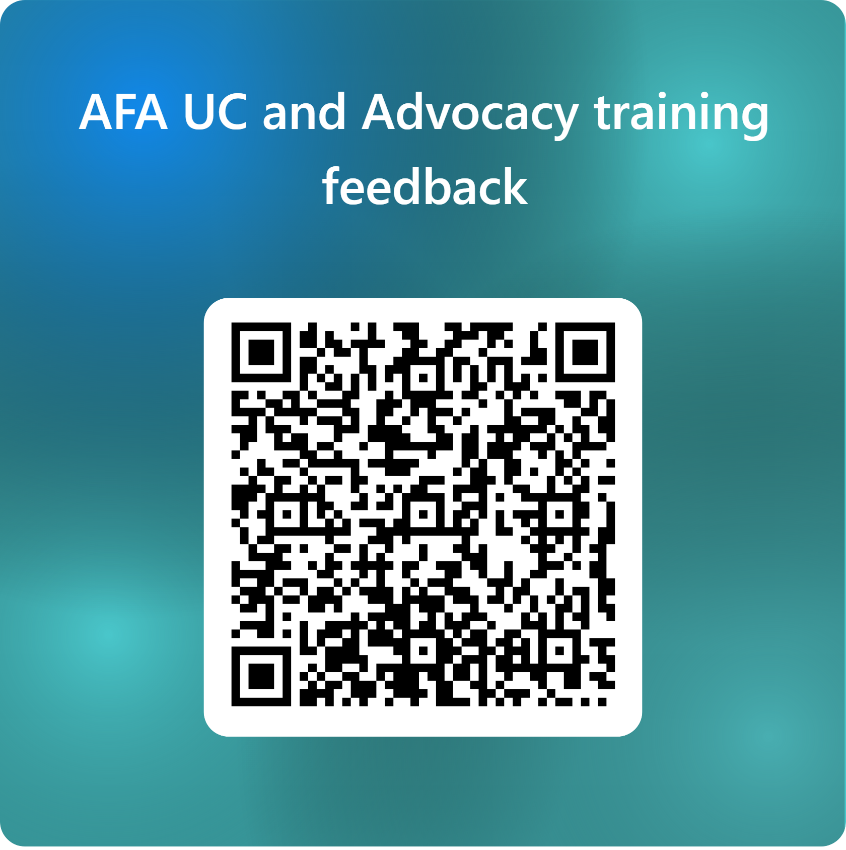
Thank you for Your Feedback
☺

Slide 30
Thank
You

